Slide 1


Customer Shopping Behavior Analysis
Analyzing 3,900 customer transactions to uncover insights into spending patterns, product preferences, and subscription behavior that drive strategic business decisions.
Created by Jnana Pravallika Kandiboyina
Notes:
1

Slide 2
Dataset Overview
Key Features Tracked
3,900
18
Customer demographics (Age, Gender, Location)
Purchase details (Category, Amount, Season)
Total Purchases
Data Points
Shopping behavior (Discounts, Reviews, Frequency)
Transactions analyzed across all categories
Features tracking customer behavior
Subscription status and shipping preferences
$59.76
3.75
Average Purchase
Avg Rating
Mean transaction value
Customer satisfaction score
Notes:
2

Slide 3

Data Preparation & Cleaning
01
Data Loading & Exploration
Imported dataset using pandas and performed initial structure analysis with df.info() and summary statistics.
02
Missing Data Handling
Imputed 37 missing Review Rating values using median rating by product category.
03
Feature Engineering
Created age_group bins and purchase_frequency_days columns for deeper analysis.
04
Database Integration
Connected to MSSQL Server and loaded cleaned data for SQL analysis.
Notes:
3

Slide 4
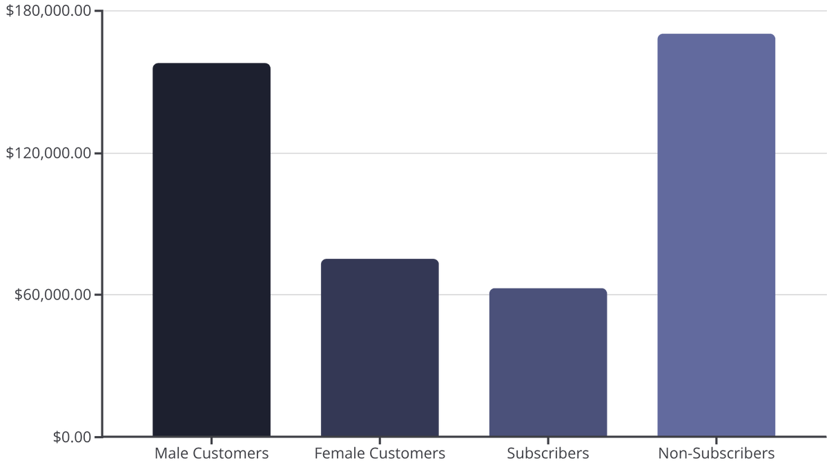
Revenue Insights
Key Findings
Male customers generate 2.1x more revenue than female customers, representing a significant opportunity for targeted marketing.
Despite lower total revenue, subscribers maintain similar average spend ($59) to non-subscribers, suggesting quality over quantity.
Notes:
4

Slide 5

Customer Segmentation Analysis
Loyal Customers
Returning Customers
3,116 customers (80%)
701 customers (18%)
Established base with consistent purchase history driving core revenue.
Growing segment showing repeat purchase behavior and conversion potential.
New Customers
83 customers (2%)
Fresh acquisition opportunities requiring nurturing strategies.
Notes:
5

Slide 6
Product Performance
Top-Rated Products
Category Leaders
Gloves
Clothing: Blouse (171 orders), Pants (171), Shirt (169)
3.86 average rating
Accessories: Jewelry (171), Belt (161), Sunglasses (161)
Footwear: Sandals (160), Shoes (150), Sneakers (145)
Sandals
Outerwear: Jacket (163), Coat (161)
3.84 average rating
Boots
3.82 average rating
Hat
3.80 average rating
Skirt
3.78 average rating
Notes:
6

Slide 7




Discount Strategy Analysis
50%
49.7%
Hat
Sneakers
Highest discount rate
Discount dependency
49.1%
48.2%
Coat
Sweater
Promotional reliance
Discount-driven sales
Critical Insight: 863 customers used discounts but still spent above average ($60+), indicating price sensitivity doesn't always correlate with lower spending. Balance promotional strategy to protect margins while driving volume.
Notes:
7

Slide 8
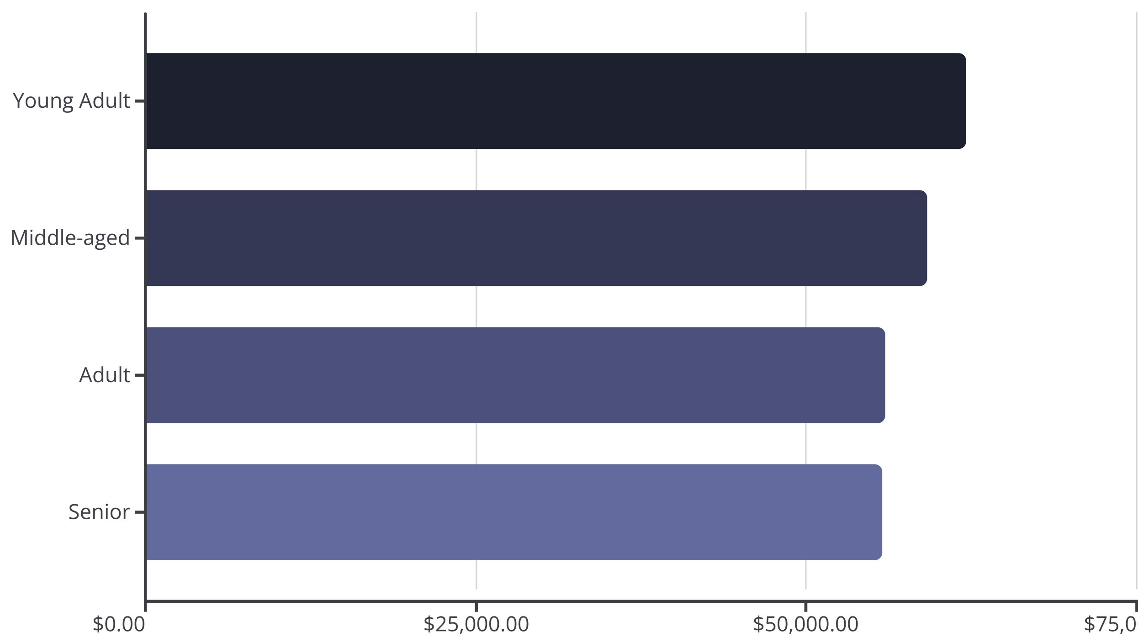
Age Group Revenue Distribution
Revenue distribution is remarkably balanced across age groups, with Young Adults leading slightly. This suggests broad market appeal and opportunities for age-specific marketing campaigns.
Notes:
8

Slide 9
Shipping & Subscription Insights
Express Shipping
958
2,518
$60 average purchase
Subscribed Repeat Buyers
Non-Subscribed Repeat Buyers
Premium customers willing to pay more for speed
Customers with 5+ purchases
Conversion opportunity
Standard Shipping
$58 average purchase
Significant untapped potential: 72% of repeat buyers haven't subscribed yet.
Cost-conscious segment with minimal difference
Notes:
9

Slide 10






Strategic Recommendations
Boost Subscriptions
Target 2,518 repeat buyers with exclusive benefits and loyalty rewards to convert them into subscribers.
Optimize Discounts
Review discount policy for high-dependency products (Hat, Sneakers, Coat) to balance volume with margin protection.
Highlight Top Products
Feature top-rated items (Gloves, Sandals, Boots) and category leaders in marketing campaigns.
Targeted Marketing
Focus on Young Adults and express-shipping users who demonstrate higher engagement and spending potential.
Notes:
10

